Slide 1


Slide 2
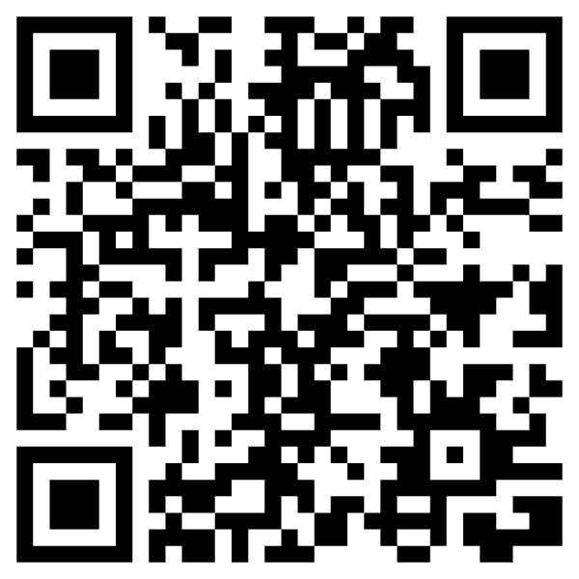


Support Senate Bill S.2625
The Independent Brokers Time Act of 2025
The only way that we affect change is by all working together to push for change desired!
YOU have the POWER
to affect change
What are we doing with the Survey
PLEASE GET INVOLVED today!
Support Bill S.2625
Contact legislators
Please allow GA to fix the shout-out link current only working for
SD and NV brokers

Slide 3
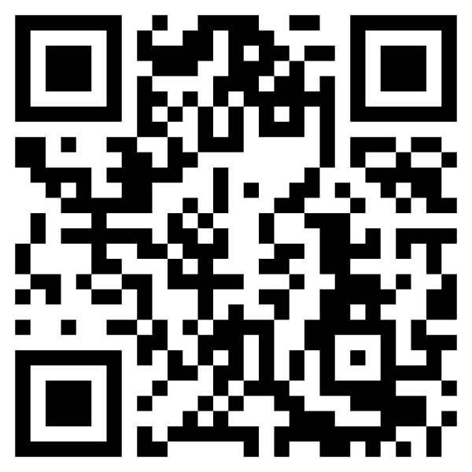
We Need You!
The only way that we affect change is by all working together to push for the change desired!
YOU have the POWER to affect change
This takes time, dedication, money and effort by ALL OF US!
PLEASE GET INVOLVED today!
NABIP
Vision 2030
Speak up

Slide 4
Currently, Surveys New Goal of 25,000
What are we doing with the Survey?
Meetings on the Hill
Agency Conversations
Letters to the Hill
Comment Letters
Meetings with Industry Entities
Press Releases and
Media Comments
Senate Finance
Committee
MedPAC –
Medicare Payment Advisory Committee
3/5 – Joint Letter with NAIFA, HAFA, CIAB, and IIABA
Response to RFP by CMS for suggested regulations to consider removing
CMS –
Center for Medicaid Medicare Services
CCIIO –
Center for Consumer Information and Insurance Oversight

Slide 5
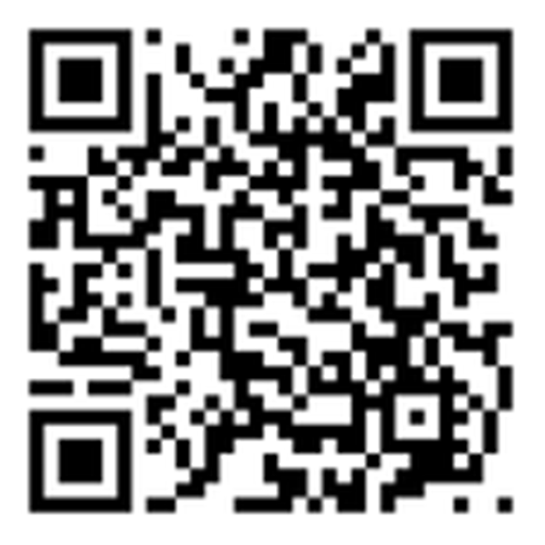
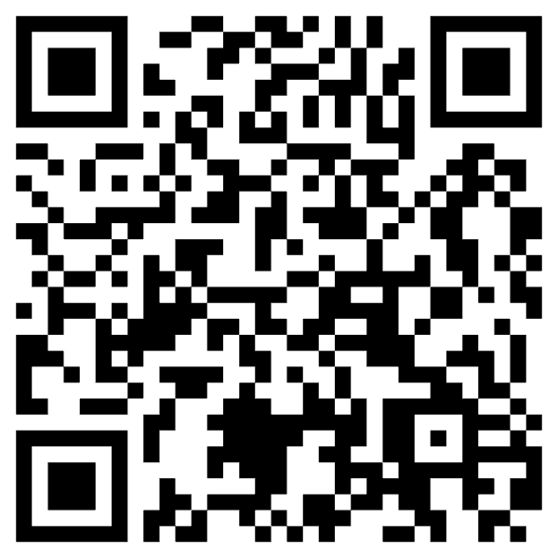
Sample Language to use with Your Clients
(YOU WANT A PICTURE OF THIS!)
Dear valued client,
We appreciate the opportunity to assist you with your Medicare | Health Insurance | Employer Benefit plans each year. As professional agents brokers we are your guide with the most current information you need to make informed decisions about plans and benefit options. We trust that you value our ability to work with you in making critical health care coverage decisions, please let your legislators why we are important to you.
We would appreciate it so much if you could take a few minutes to complete this short 5 question survey (see link below). The professional Association that we belong to the National Association of Benefit and Insurance Professionals (NABIP) will be forwarding the information from surveys to CMS and your legislators.
Thank you in advance for your support. We appreciate you!
select the Client Survey link
https://votervoice.net/mobile/NABIP/Surveys
For Medicare use the link below
votervoice.net/mobile/NABIP/Surveys/11551/Respond
For ACA use this link below
https://votervoice.net/mobile/NABIP/Surveys/11766/Respond
SCAN ME!
SCAN ME!
MA clients
ACA clients

Slide 6
We are Advocating for You!
Surveys Results for used with legislators, regulators, and the media
NABIP lobbyists are meeting with legislators every single day on pressing Health Care Policy issues.
Communications to Congress & CMS on AEP & OEP & compensation issues, e.g. Medicare Advantage, ACA, Prescription Drugs and PBM issues including IRA impacts.
Partner with NAIFA, IIABA, CIAB, HAFA, and others to elevate issues facing agents, brokers and beneficiaries within the all markets.
Provide NABIP members with self-advocacy tools, including testimonial booklets distributed at Cap Con, for govt conversations.
NABIP leading the media coverage of agents and brokers critical professional roles vs. other associations.
    2 new testimonial videos giving face to the issues
Medicare Advisory Group members actively meet to influence organizational Medicare strategy. clink link to view
Podcast episode on commissions.
It’s Go Time – Get Involved!
Last updated 03/10/25

Slide 7
Now is the Time to Get Involved!
Join NABIP
Join the thousands of other industry professionals! Join now at nabip.org
Donate
Anyone can donate to the NABIP Foundation at nabipfoundation.org to help raise awareness of how Brokers and Agents are needed
For the latest updates, follow NABIP on Facebook, LinkedIn, Instagram, YouTube and Twitter
Follow on Social Media
Wear Your Pride
Get your Brokers Making a Difference and NABIP embroidered apparel and hats now at https://nabip.qbstores.com/

Slide 8
Now is the Time to Get Involved!
Surveys
Tell other agents about the need for surveys and ask your clients to complete the Surveys! SEE NEXT SLIDE
Legislators
Use NABIP Talking Points and schedule meetings with your federal legislators and stay tuned to the Washington Update for additional opportunities to advocate with regulators. WE CAN HELP YOU WITH THIS!
Come to D.C. and join hundreds of other members to meet with your federal legislators and their staff in person! Congress is in session!
Mark Your Calendar for February 22-25, 2026
Cap Con
NABIP PAC
NABIP members can donate and help raise funds for campaigns of politicians who support NABIP’s positions.

Slide 9
How It Started
2022 CMS Final Rule Implementation of Call Recording and the change of the TPMO definition to presented significant hurdles for individual Agents & Brokers.
Continued changes and discussions created a need for us to better share what Insurance Agent and broker do and how it is more than just taking an enrollment application
2024 Michele Malooley kept pushing for us to bring back the Brokers Making a Difference initiative where we asked our clients to share their experience.
September 2024, NABIP Medicare Advisory Group (MAG) started a campaign to empower agents and brokers to get involved and help us collect client experiences with a simple 5 question survey that only NABIP staff as access to the answers.

Slide 10
How It Started
Change is hard without skepticism - “A single survey isn’t going to do anything to fix the issues!”
  BET!
Weekly social media posts including a sample email, QR code, and ways to include in agents and brokers retention efforts proved successful and displayed overwhelming support - clients wanted to help.
We did it! Collectively…… 14,000 Medicare Client Surveys!

